Slide 1

Testing
An Introduction to Software Testing
Gholamhossein Tavasoli @ ZNU

Slide 2
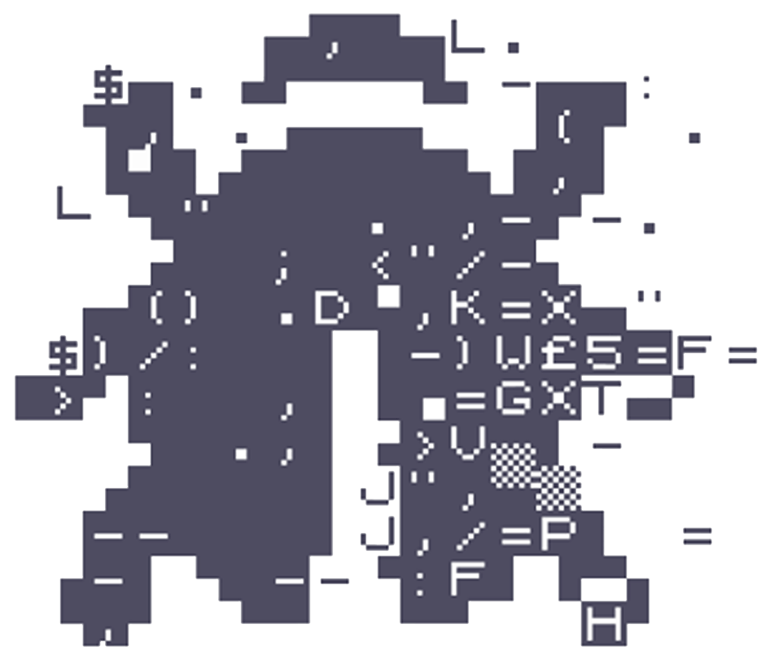
Type of Bugs
Security
Regression
Business Logic
Accessibility
Performance
User Interface
Integration
Internationalization
Scaling

Slide 3

Some Famous Software Failures
Heartbleed
Heartbeat Extension of TLS is used to keep Datagram TLS sessions open.
Simple request and response scheme:
“send me back the following (padded) string which is n bytes long.”
An attacker just had to request a long string, while telling it is short.
Other party responded with short string, then leaked potentially confidential data.
Video (https://youtu.be/WgrBrPW_Zn4)
heartbleed.com

Slide 4

Some Famous Software Failures
Ariane-5
Inertial navigation software taken from Ariane-4. Untested.
All other systems thoroughly tested component-by-component.
Ariane-5 had a different trajectory than Ariane 4.
Converting 64-bit floating-point data into 16-bit unsigned integer values. → Arithmetic overflow.
There was an exception handler for that. It had been disabled.
Not even 40 seconds after launch, Ariane-5 literally self-destructed. Successfully.
Video (https://youtu.be/WgrBrPW_Zn4)

Slide 5
Why Testing?
Software contains defects. The hide.
Defects can cause software failures.
Failures can cost money, and even be mortal!
Testing assures the quality of the software.
Testing accelerates software development.
And much, much more.

Slide 6
Why Testing?
Debug is NOT testing!
Software contains defects. The hide.
Defects can cause software failures.
Failures can cost money, and even be mortal!
Testing assures the quality of the software.
Testing accelerates software development.
And much, much more.

Slide 7
What is Testing?
The process consisting of all life cycle activities, both static and dynamic, concerned with planning, preparation and evaluation of software products and related work products to determine that they satisfy specified requirements, to demonstrate that they are fit for purpose and to detect defects.

Slide 8
Do Software Testing. Right.
Testing has to be planned.
Testing costs easily up to 40% of a project's budget.
Testing has to be performed in a reasonable way.
Testing shall be independent and objective.
Testing has to be managed.
Software testing is a fundamental part of professional software development!

Slide 9
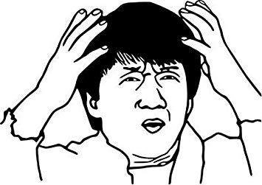
Type of Tests
Unit Testing
Integration Testing
E2E Testing
Penetration Testing
Performance Testing
Regression Testing
a11y Testing
Stress Testing
Fuzz Testing
A/B Testing
User Acceptance Testing
Usability Testing
i18n Testing
Smoke Testing

Slide 10
Test Levels
Unit Testing
Test individual units in isolation.
Find defects in software components (e.g., functions, classes).
Done by developers.
In general, white-box tests.

Slide 11
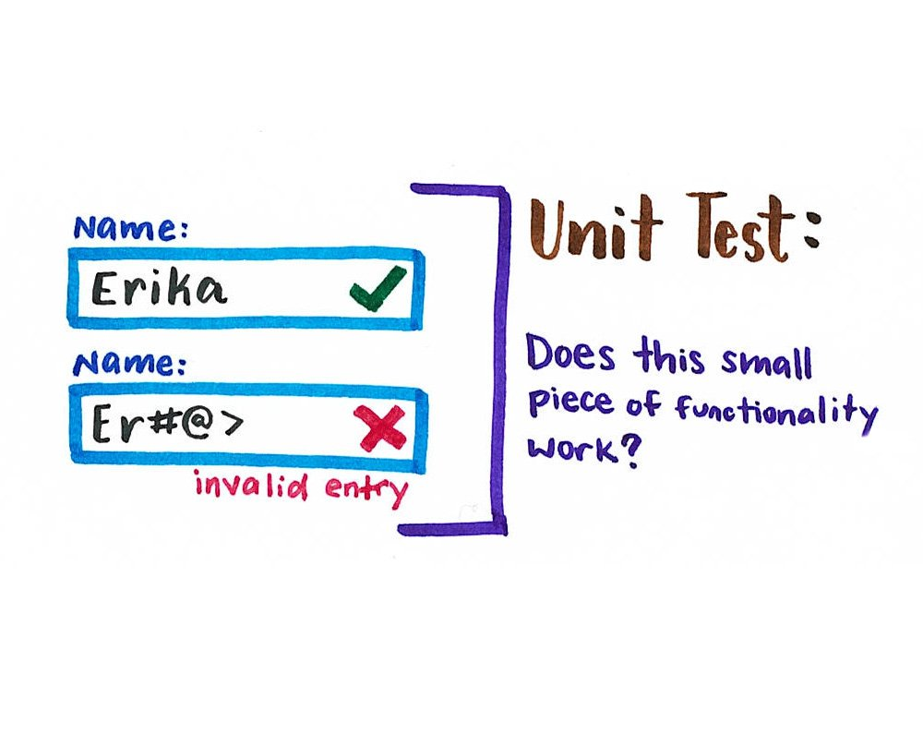
What is a Unit Test?

Slide 12
Test Levels
Unit Testing
Integration Testing
Test communication/interaction of units (i.e., their interfaces).
Maybe separate unit integration and system integration tests.
Done by developers.
Primarily white-box tests, but also black-box tests.

Slide 13
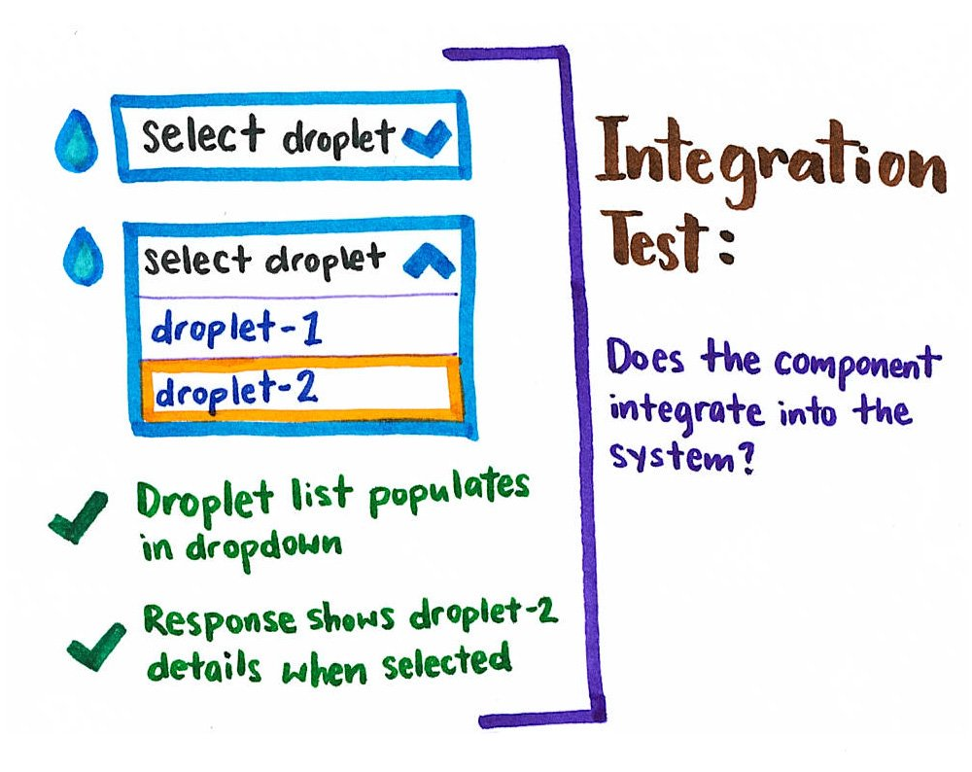
What is a Integration Test?

Slide 14
Test Levels
Unit Testing
Integration Testing
System Testing
Test complete, integrated system.
Evaluate system compliance with specified requirements.
Stress, performance, usability etc. testing.
Done by (external) testers.
In general, black-box tests. Additional white-box tests possible.

Slide 15
Test Levels
Unit Testing
Integration Testing
System Testing
Acceptance Testing
Test complete, integrated system.
Evaluate system compliance with specified acceptance criteria.
May be performed at various times during development.
Done by customers/users.
Only black-box tests

Slide 16






App
Technologies
Python
Flask
Flaskr
NGINX
uWSGI
Environment
Ubuntu Server (VM)
PyCharm

Slide 17
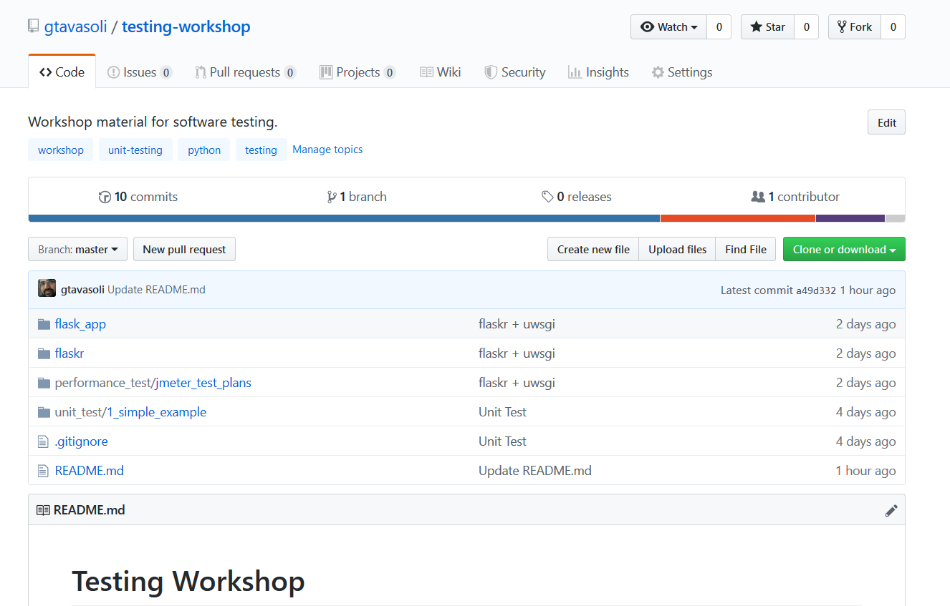
Setup
git clone https://github.com/gtavasoli/testing-workshop.git
cd testing-workshop

Slide 18
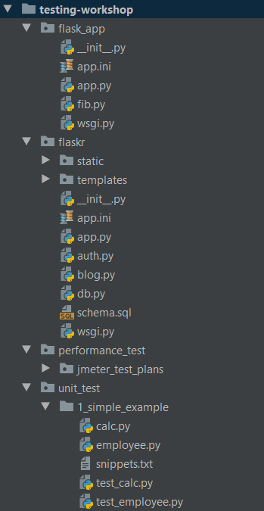
App Structure
Unit Tests
Simple Flask Apps
Flaskr
JMeter Profiles

Slide 19
Unit Test
Unit test in python

Slide 20
Unit Testing
Sample 1 – Calculator
Test operators
Floating point division
Division by zero
Sample 2 – Employee
Setup & Teardown
Setup & Teardown Class

Slide 21
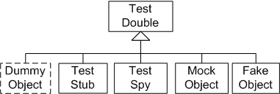
Test Double
Notes:
Test Double is a generic term for any case where you replace a production object or procedure with another for testing purposes. In automated unit testing, a test double replaces an object on which the System Under Test (SUT) depends on.
Test doubles are popularly (and incorrectly) called Mock objects, but in reality, a mock object is a very specific type of test double.

Slide 22
Test Double
Dummy → I do nothing at all but to fill parameter list
Stub → canned Answers
Spy → stubs + interaction recording (for late interaction expectations verification)
Mock → stubs + expectations on interaction
Fake → I seem real but no

Slide 23
What Are Mocks?
The term 'Mock Objects' has become a popular one to describe special case objects that mimic real objects for testing.
Mocking makes unit testing easier!
Verifies behavior (calls) to a method.
A mock object simulates the behavior of real objects in controlled ways.
Notes:
In unit testing the problem is that to make a single unit work, you often need other units - hence the need for some kind of warehouse in our example.

Slide 24
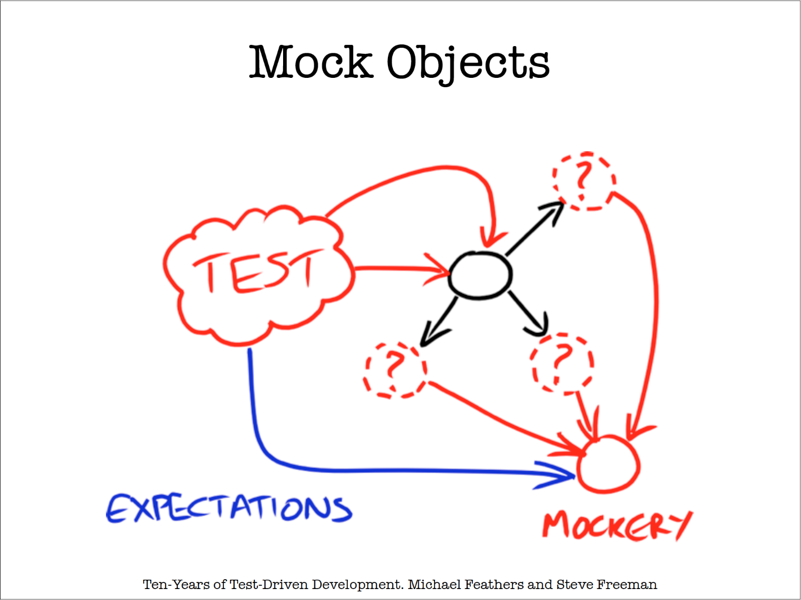
What Are Mocks?
Notes:
In unit testing the problem is that to make a single unit work, you often need other units - hence the need for some kind of warehouse in our example.

Slide 25
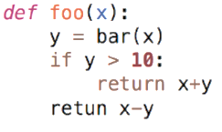
Problems Mocks Solve
Eliminates dependencies in the CUT (class under test)
Isolate Unite Tests
foo(x)
bar(x)
Copyright: Based on “Mocking Strategies” – slides from 26 to end of mocking sample

Slide 26
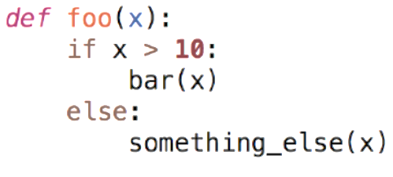
Problems Mocks Solve
Tests methods that have no return value
How do we know that bar(x) has been called?

Slide 27
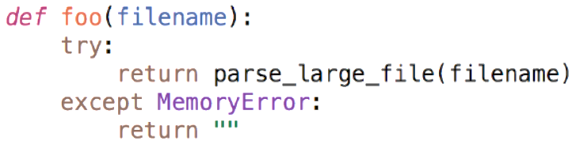
Problems Mocks Solve
Tests error handling
How do we generate this exception???

Slide 28
Problems Mocks Solve
Eliminate dependency on database calls
Speed up testing!
Reduce test complexity
Don’t have to write complex logic to handle behavior of methods not under test
Don’t have to wait to implement other methods

Slide 29

Problem: Friend Finder App
Create a method to return a new, random friendship candidate
Must not show the same person
Must not show someone the user has already visit it.

Slide 30
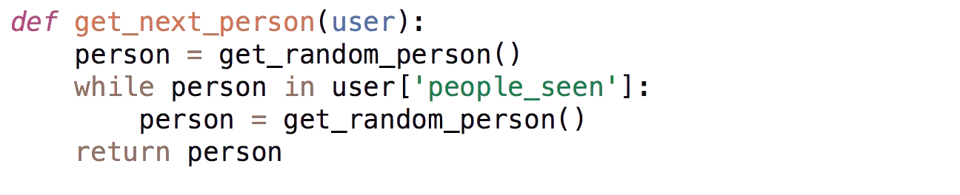
Easy Method
“Surely no one could have seen EVERYONE in the database!!!”
get_next_person()
get_random_person()

Slide 31
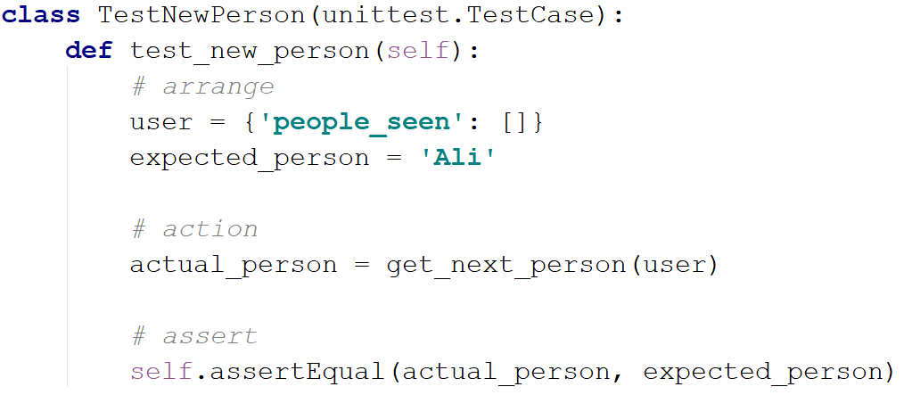
Write a Unit Test...

Slide 32
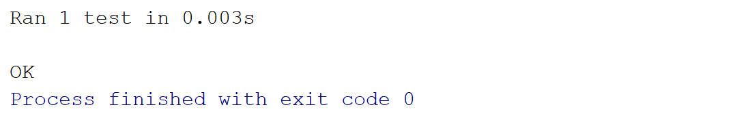
May be it Works!!!

Slide 33
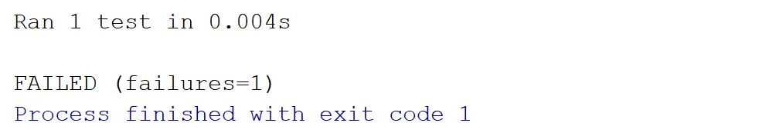
May be don’t!

Slide 34
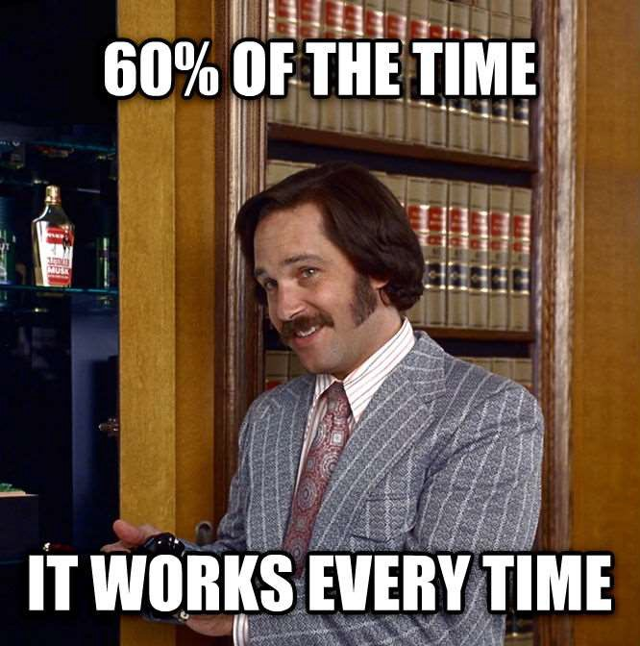

Slide 35
Easy Method
What if knew the result of get_random_person()???

Slide 36

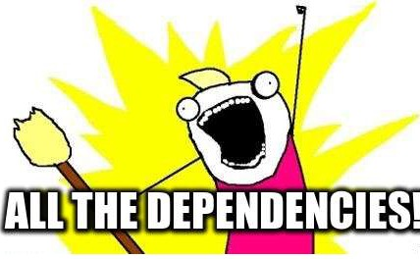

Slide 37
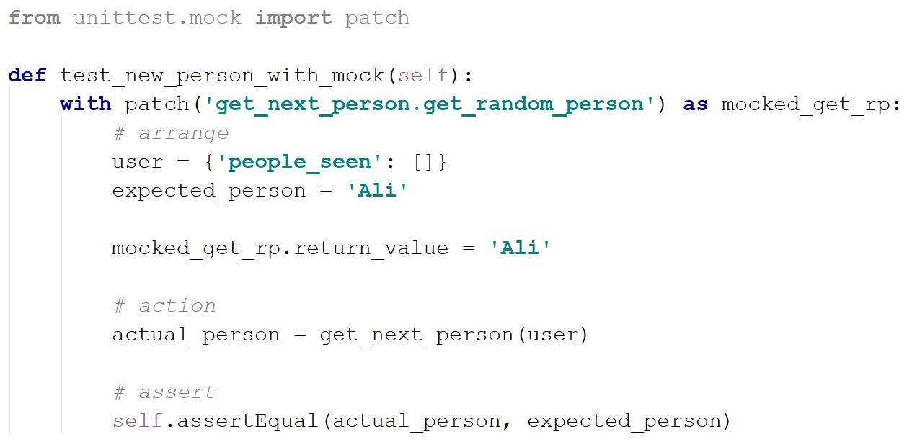
Patching
It works EVERY SINGLE TIME!!!

Slide 38
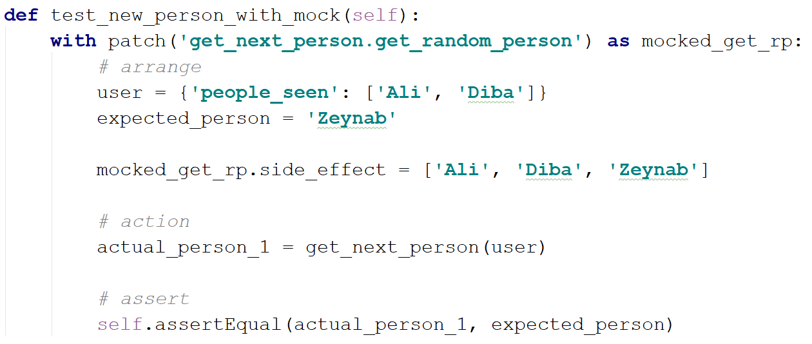
But what if we call it multiple times???

Slide 39

Warning
A warning about over-isolating
Many people fall for relentless isolation
Magic tool for helping in isolating parts
Mocking is about object communication and interface discovery
Using it for isolation is a misuse
Specially from 3rd party code
General rule of thumb: "do not mock what you don’t own"

Slide 40
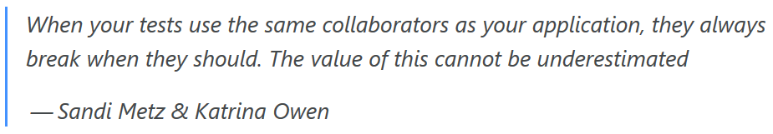
Warning
Avoid over-mocking
Duplicating implementation code in the tests
Keep production and test code in sync
We should refrain from this and try as much as possible to use real collaborators when possible.

Slide 41

Testing/Coding is so hard!!

Slide 42


Slide 43
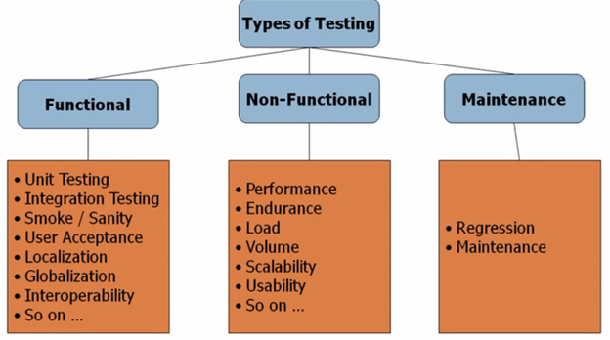
Type of Software Testing
Notes:
Functional testing is a type of testing which verifies that each function of the software application operates in conformance with the requirement specification.

Slide 44
Non-functional Testing
Performance Testing
To identify any bottlenecks or performance issues rather than finding bugs in a software
Speed
Capacity
Stability
Scalability

Slide 45
Non-functional Testing
Performance Testing
Load Testing
The process of testing the behavior of a software by applying maximum load in terms of software accessing and manipulating large input data
Tools
Load Runner, AppLoader, IBM Rational Performance Tester, Apache JMeter, Silk Performer, Visual Studio Load Test, etc.

Slide 46
Non-functional Testing
Performance Testing
Load Testing
Stress Testing
Includes testing the behavior of a software under abnormal conditions
Applying the load to the system and taking over the resources used by the software to identify the breaking point

Slide 47
Non-functional Testing
Performance Testing
Load Testing
Stress Testing
Shutdown or restart of network ports randomly
Turning the database on or off
Running different processes that consume resources such as CPU, memory, server, etc.

Slide 48
Non-functional Testing
Performance Testing
Security Testing
Confidentiality
Integrity
Authentication
Availability
Authorization
…

Slide 49
Performance Testing
Methodologies
Real User Monitoring - RUM
Synthetic Testing
The Recipe
Step 1 – Collect Data
Step 2 – Analyze
Step 3 – Experiment
Step 4 – GoTo 1
Notes:
https://www.youtube.com/watch?v=yrRqNzJTBjk&list=WL&index=78&t=0s (2:0)

Slide 50
Targets in Performance Testing
Things we measure
Availability or uptime
Concurrency
Throughput
Response time
Network utilization
Server utilization

Slide 51
Tips
Beware of failures
Be aware of caching
Automate bookkeeping

Slide 52
Tutorial 1 – Simple Test
Step 1 – Start JMeter
Step 2 – Create a TestPlan
Step 3 – Create a Thread Group (Users)
Step 4 – Add Sampler (HTTP)
Step 5 – Add Listeners
Step 6 – To Run the Test

Slide 53
Tutorial 2 – Using Assertions
Response Assertion
Duration Assertion
Size Assertion
HTML Assertion

Slide 54
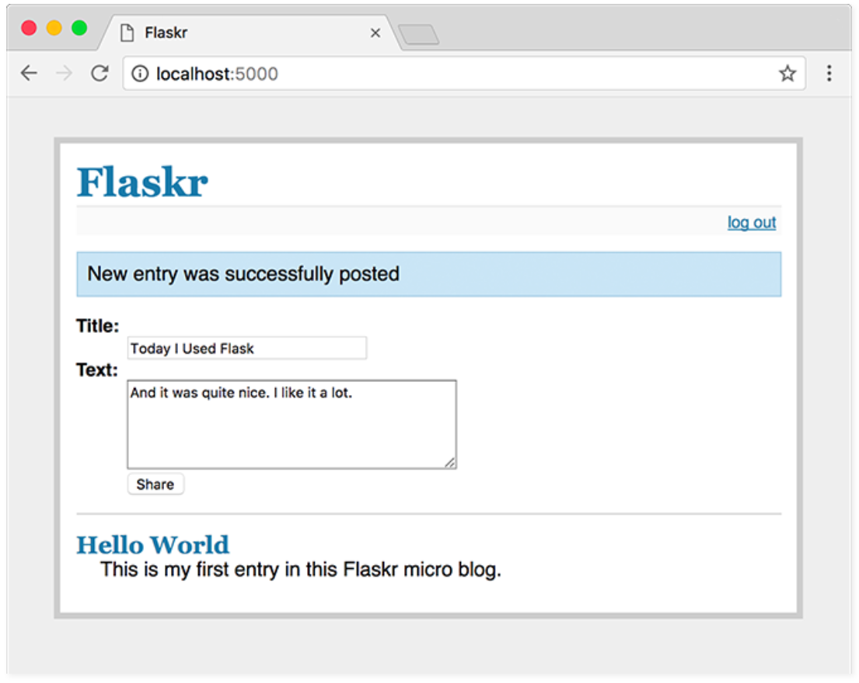
Tutorial 3 – Flaskr
Simple Microblog With Flask
Parametric Request

Slide 55
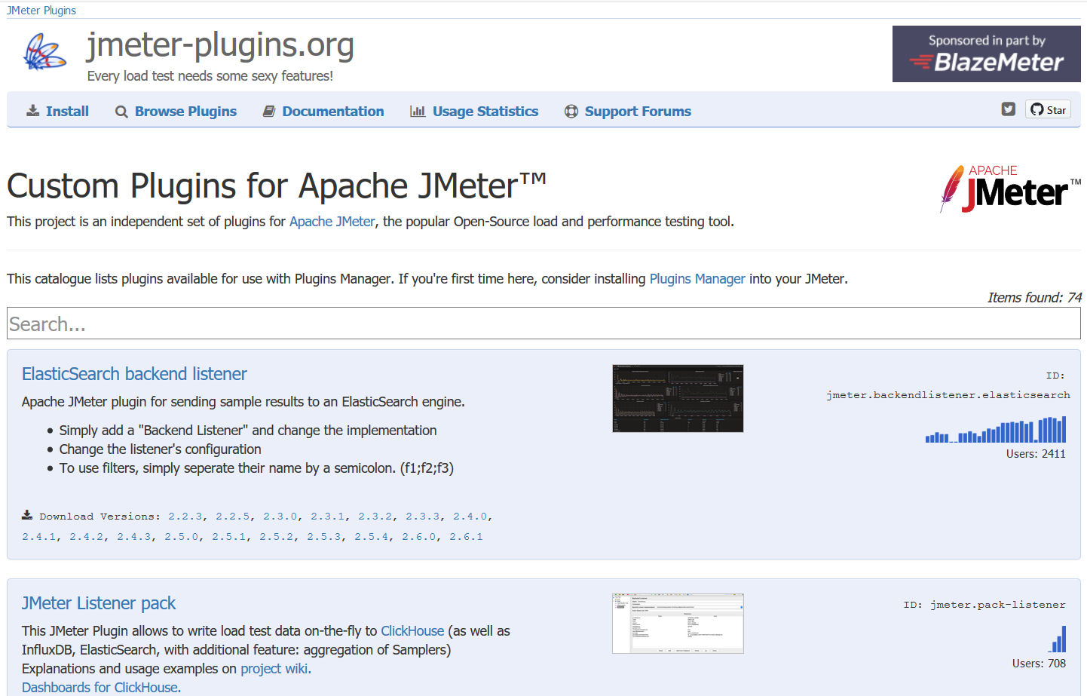
Tutorial 4 – JMeter Plugins
https://jmeter-plugins.org/

Slide 56
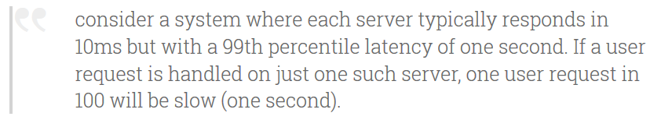

Tutorial 4 – JMeter Plugins
JMeter Plugin: Response Times Percentiles / Distribution
Tail Latency
The Tail at Scale – Dean and Barroso 2013

Slide 57
Tutorial 4 – JMeter Plugins
What happens when there is not just a single server involved in servicing a request, but 100! (fan-out query, contribution of a large number of microservices)

Slide 58
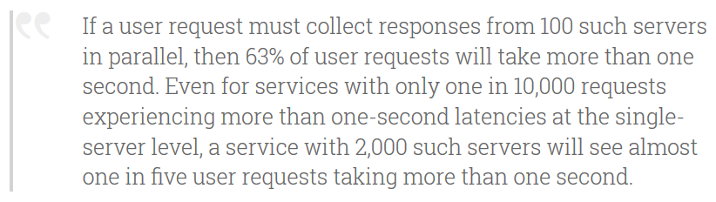
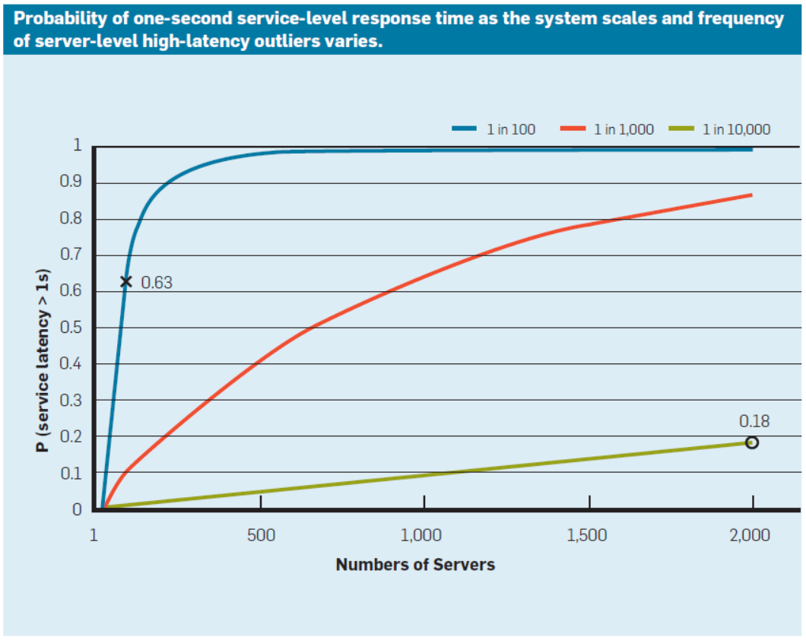
Tutorial 4 – JMeter Plugins

Slide 59
Tutorial 4 – JMeter Plugins
Tail Latency
Root Causes
Shared resources (memory, CPU cores, CPU caches, shared file system)
Background tasks running on the server
Maintenance activities (GC, Log rotation)
Queues in general
https://blog.acolyer.org/2015/01/15/the-tail-at-scale/

